Slide 1

Functional Analysis
Center for Health Data Science

Slide 2
Agenda
Count matrix and normalization
RPKM/FPKM-TPM-DESeq2
Exploratory analysis
PCA, Pearson correlation,
distance heatmaps
Workflow
Differential Expression Analysis
Comparison between conditions
Functional analysis
Gene-gene correlation
Networks
GO term

Slide 3
Functional analysis
DEA gave us genes UP and DOWN regulated in each comparison
Define sets of genes of interest:
Treatment vs Control with Log2FC > 1 and adjusted p-value <0.05
What do these genes do?
Do they share a common function? Eg: immunoprocesses
Part of the same pathway? Eg: nucleotide metabolism

Slide 4
Functional analysis
Gene annotation
We can annotate our genes of interests with different information
Sometimes we need specific gene identifiers or gene names
Use of databases to annotate our genes: AnnotationHub or Biomart
Use same genome build!
Eg: grch37
Gene_name | Gene_id | Entrezid | Chr | Start | End
ENSG00000223972 | DDX11L1 | NA | 1 | 11869 | 14409
ENSG00000227232 | WASH7P | NA | 1 | 14404 | 29570
ENSG00000278267 | MIR6859-1 | NA | 1 | 17369 | 17436

Slide 5
GO term and pathway analysis
GO term
Formal representation of a body of knowledge in the biological domain
Genes are annotated to different sets of knowledge
Biological processes: DNA repair, signal transduction, etc.
Molecular function: catalysis, transportation, etc.
Cellular component: ribosome, nucleus, etc.
GO terms have children and children have multiple parents
Notes:
Gene ontology webpage: http://geneontology.org/
KEGG pathway database webpage: https://www.genome.jp/kegg/pathway.html

Slide 6
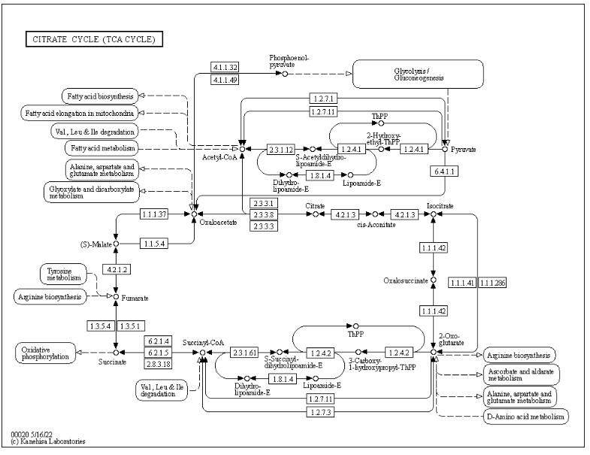
GO term and pathway analysis
Pathways
Set of genes connected to each other in a specific biological function
KEGG pathway database
Metabolism
Genetic information processing
Environmental Information Processing
Cellular processes
Organismal Systems
Human Diseases
Notes:
Gene ontology webpage: http://geneontology.org/
KEGG pathway database webpage: https://www.genome.jp/kegg/pathway.html

Slide 7
Enrichment Analysis
Definition
Identify classes of genes that are over-represented in a large set of genes, and may have an association with a body of knowledge
Returns scores or p-values
Different ways:
GEA
GSEA
MEA
https://doi.org/10.1016/j.coisb.2019.04.002
Notes:
Read more! https://www.sciencedirect.com/science/article/pii/B9780128096338204044

Slide 8
Enrichment Analysis
Example: GEA or overrepresentation
Are my regulated genes enriched in Kinases (Gene Ontology)?
Create a contingency table where:
Perform a Fisher’s exact test to check if there is enrichment → p-value
There are thousands of GO sets, so multiple testing correction is needed
 | Kinase | Not kinase
Regulated | A | B
Not regulated | C | D
Notes:
Read more! https://www.sciencedirect.com/science/article/pii/B9780128096338204044

Slide 9
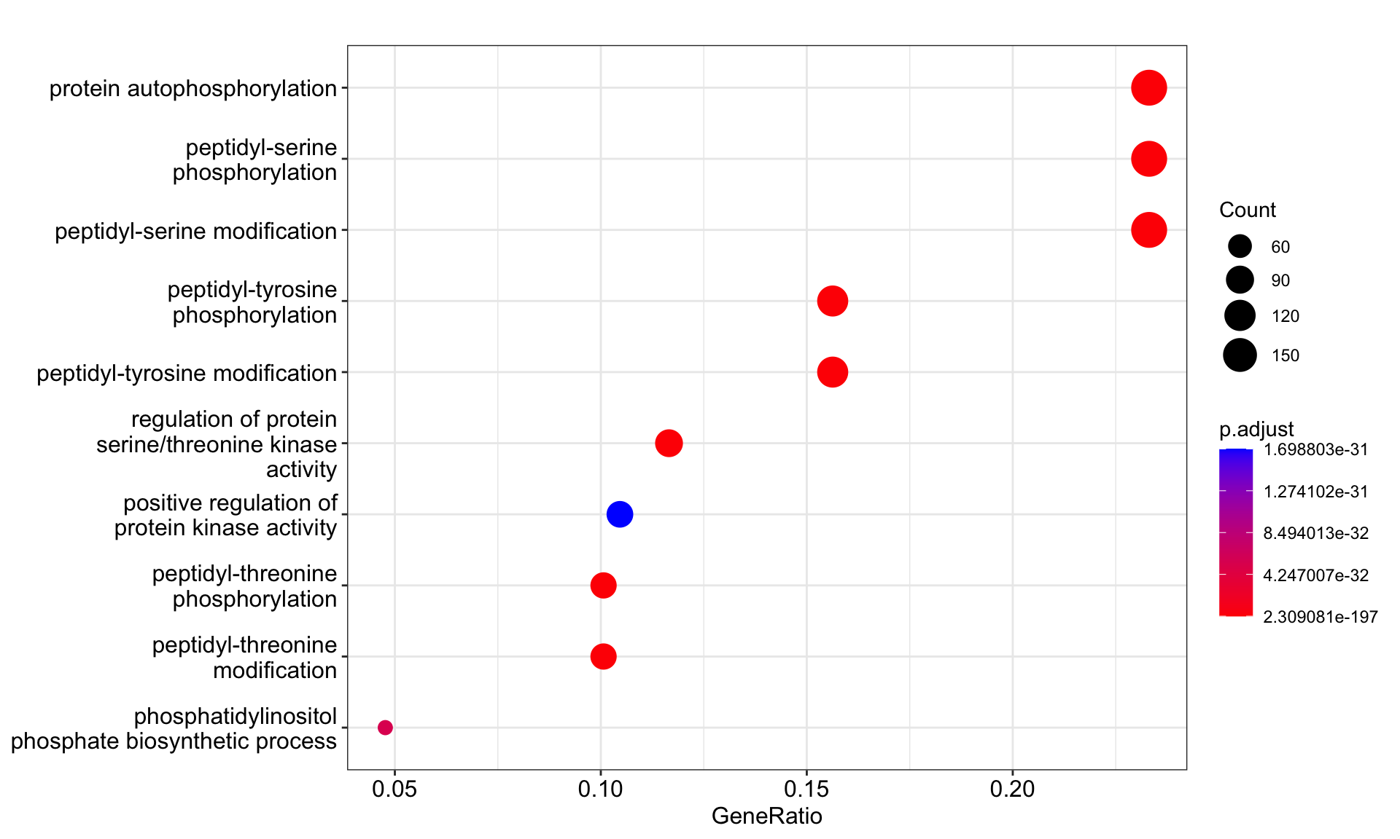
Enrichment Analysis
Quiz: Enrichment Analysis on a kinase screen
Our experiment returns a list of regulated kinases
What would come out as enriched in our analysis?
 | Kinase | Not kinase
Gene list | A | B
Not gene list | C | D
Notes:
Read more! https://www.sciencedirect.com/science/article/pii/B9780128096338204044

Slide 10
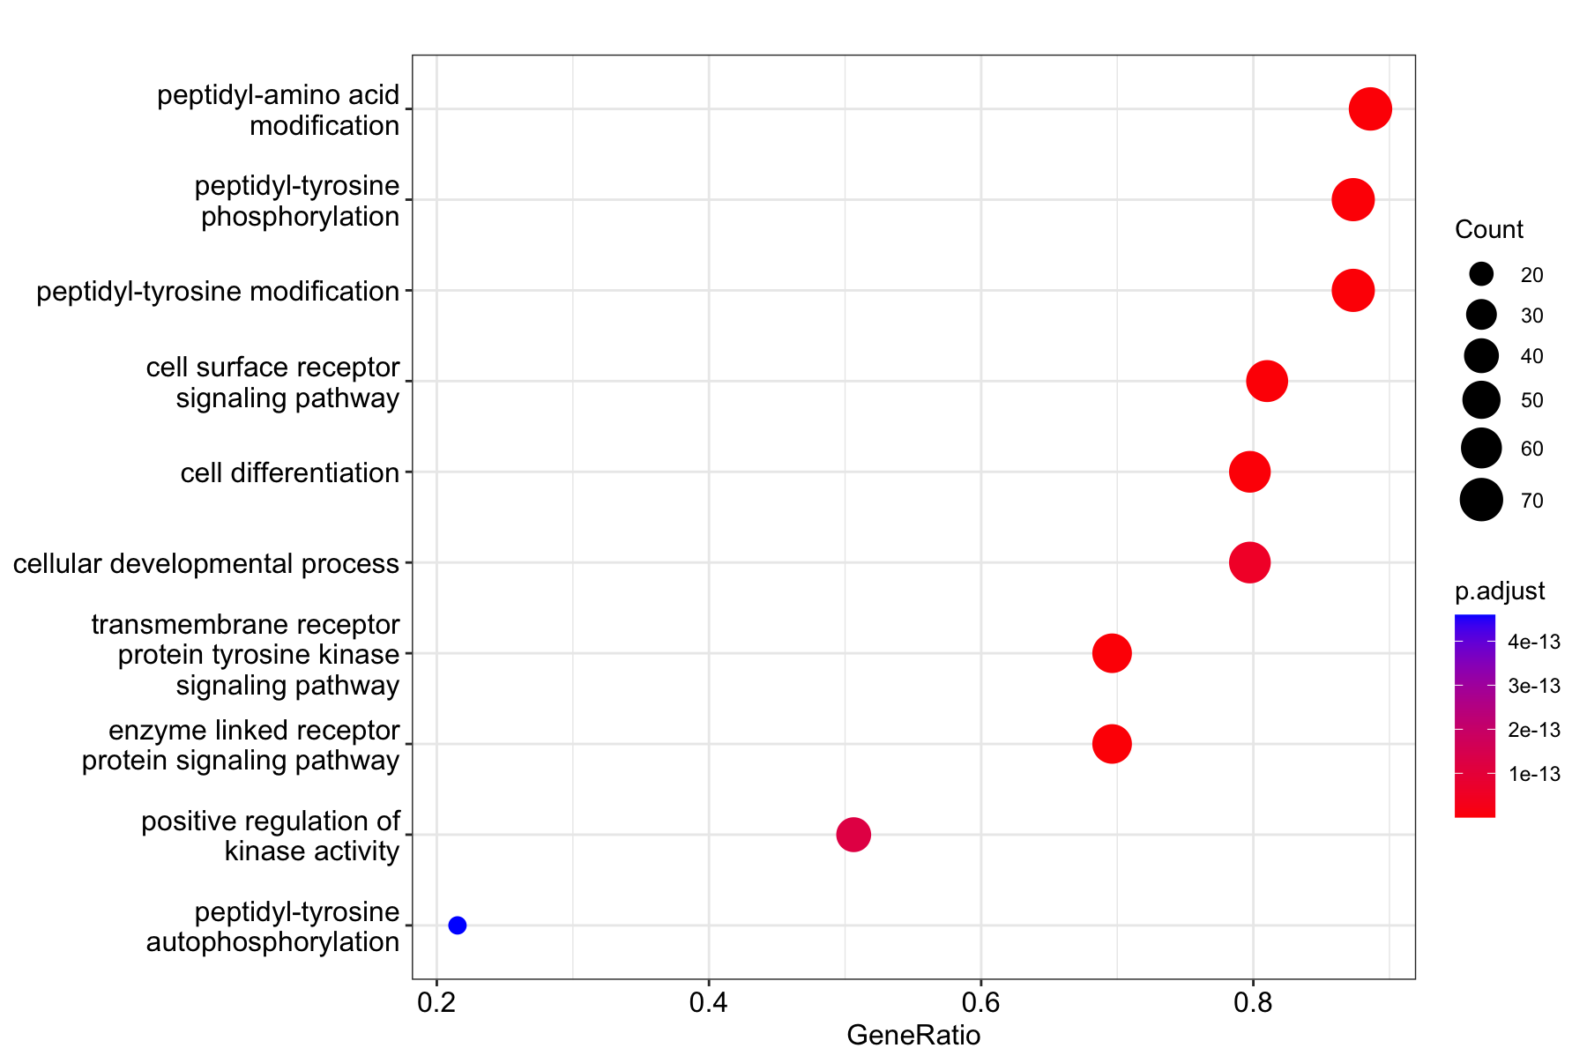
Enrichment Analysis
Quiz: Enrichment Analysis on a kinase screen
Change the gene background!
Instead of all genes, use a custom background: only kinome
 | Kinase subclass | Other kinases
Gene list | A | B
Not gene list | C | D
Notes:
Read more! https://www.sciencedirect.com/science/article/pii/B9780128096338204044

Slide 11
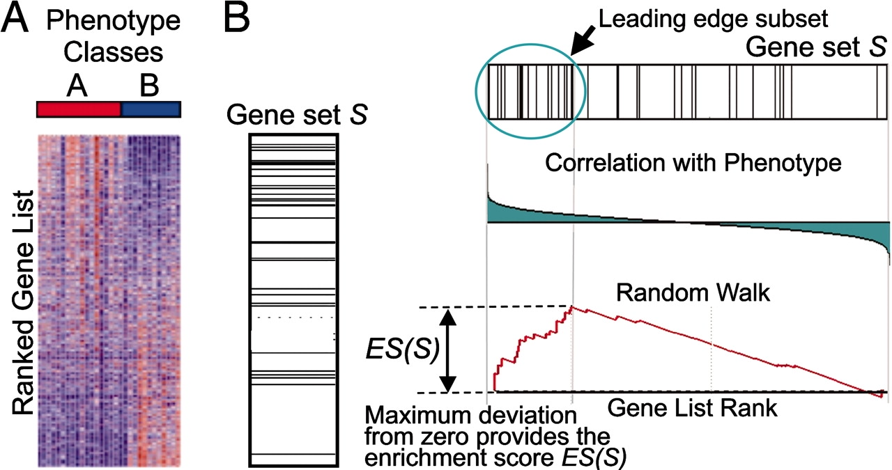
Enrichment Analysis
Example: GSEA or class scoring
Are my regulated genes enriched in Kinases (Gene Ontology)?
Rank my DE results by log2FC
Run enrichment score
Pro:
No need for gene list!
Best for small DE lists
DOI: 10.1073/pnas.0506580102
Notes:
Read more! https://www.sciencedirect.com/science/article/pii/B9780128096338204044

Slide 12
Enrichment Analysis. Tools
PANTHER, DAVID, GOrilla, clusterProfiler
Notes:
Gene ontology tools
GOrilla: http://cbl-gorilla.cs.technion.ac.il/
PANTHER: http://www.pantherdb.org/
Ontologizer: http://ontologizer.de/
KEGG pathway analysis:
DAVID: https://david.ncifcrf.gov/
Gprofiler: https://biit.cs.ut.ee/gprofiler/gost

Slide 13
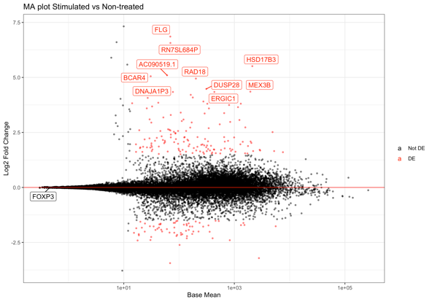
Workflow
Experimental design
Create gene count matrix
Normalization
 | Unt 1 | Unt 1 | Treat 2 | Treat 2
Gene A | 123 | 150 | 143 | 130
Gene B | 18 | 10 | 233 | 209
DESeq
 | Unt 1 | Unt 1 | Treat 2 | Treat 2
Gene A | 13.8 | 14.2 | 12.4 | 14.6
Gene B | 1.9 | 1.25 | 24.1 | 20.9
Untreated
Treated
Sample comparison
GO term and pathway analysis
DE analysis
GOrilla,
DAVID,
PANTHER
Distance heatmap and PCA
DESeq
MA plots, Volcano plots or Heatmaps

Slide 14
Gene-gene correlation analysis
Identify clusters of genes correlating with each other in a condition
Replicates and conditions are compared
Clusters can be used for GO term and pathway
analysis
Tools: DGCA
https://doi.org/10.1186/s12918-016-0349-1

Slide 15
Gene network analysis
Genes of interest can be used to construct networks
Network: set of interconnected nodes
Nodes: entities we want to connect (genes, proteins, diseases, etc)
Edges: relationship between nodes (correlation, connection)
Attributes: Information about the network
Color and shape: e.g. differentiate genes from diseases
Arrow head: direction of the relationship
Edge thickness: strength of relationship
Nodes
Edges
Notes:
Cytoscape: https://cytoscape.org/

Slide 16
Gene-gene network analysis
Gene correlations for differential changes between conditions
Annotation of the network:
diseases or drugs (Clinical Knowledge Graphs)
protein interactions
transcription factors, etc.
Network can be as well divided in subsets
Network tool: Cytoscape
Annotation for network: String
https://doi.org/10.1186/s12918-016-0349-1
https://www.youtube.com/c/LarsJuhlJensen
Notes:
Cytoscape: https://cytoscape.org/

